Slide 1

Unit II Decision Making and Support System Business Intelligence and Data Analytics
Mrs. Madhuri Prashant Karnik
Department of Computer Engineering
BRACT’S, Vishwakarma Institute of Information Technology, Pune-48
(An Autonomous Institute affiliated to Savitribai Phule Pune University)
(NBA and NAAC accredited, ISO 9001:2015 certified)

Slide 2
2
Unit II Decision Making and Support System
Department of Computer Engineering, VIIT , Pune-48

Slide 3
3
Topics
Concept of Decision Making system and its importance.
Decision making process.
Common strategies and approaches of decision makers.
Decision support system(DSS) : Role of DSS, its main components, its various techniques.
Types and classification.
Applications of DSS.
Role of Business intelligence in DSS.
Department of Computer Engineering, VIIT , Pune-48

Slide 4
4
Database queries are often designed to extract specific information, such as the balance of an account or the sum of a customer’s account balances.
However, queries designed to help formulate a corporate strategy usually requires access to large amounts of data originating at multiple sources.
A data warehouse is a repository of data gathered from multiple sources and stored under a common, unified database schema.
Data stored in warehouse are analyzed by a variety of complex aggregations and statistical analysis.
Department of Computer Engineering, VIIT , Pune-48

Slide 5
5
Furthermore, knowledge-discovery techniques may be used to attempt to discover rules and
patterns from the data.
For example, a retailer may discover that certain products tend to be purchased together, and may use that information to develop marketing strategies.
Department of Computer Engineering, VIIT , Pune-48

Slide 6
6
Decision-Support Systems
Database applications can be broadly classified into transaction-processing and decision-support systems.
Transaction-processing systems are systems that record information about transactions, such as product sales information for companies, or course registration and grade information for universities.
Transaction processing systems are widely used today, and organizations have accumulated a vast amount of information generated by these systems.
Department of Computer Engineering, VIIT , Pune-48

Slide 7
7
Decision-support systems aim to get high-level information out of the detailed information stored in transaction-processing systems, and to use the high-level information to make a variety of decisions.
Decision-support systems help managers to decide what products to stock in a shop, what products to manufacture in a factory.
Department of Computer Engineering, VIIT , Pune-48

Slide 8
The Complete Decision Support System
Information Sources
Data Warehouse
Server
(Tier 1)
OLAP Servers
(Tier 2)
Clients
(Tier 3)
e.g., MOLAP
Semistructured
Sources
OLAP
Data
Warehouse
serve
extract
transform
load
refresh
etc.
Query/Reporting
serve
e.g., ROLAP
Operational
DB’s
serve
Data Mining
Data Marts
Department of Computer Engineering, VIIT , Pune-48

Slide 9
9
Decision-Support Systems
A decision support system (DSS) is a computer program application that analyzes business data and presents it so that users can make business decisions more easily.
It is an "informational application" (to distinguish it from an "operational application" that collects the data in the course of normal business operation).
Department of Computer Engineering, VIIT , Pune-48

Slide 10
Concept of Decision Support Systems
Classical Definitions of DSS
Interactive computer-based systems, which help decision makers utilize data and models to solve unstructured problems" - Gorry and Scott-Morton, 1971
Decision support systems couple the intellectual resources of individuals with the capabilities of the computer to improve the quality of decisions. It is a computer-based support system for management decision makers who deal with semistructured problems - Keen and Scott-Morton, 1978
Department of Computer Engineering, VIIT , Pune-48

Slide 11
Structured Problems
Structured problems are repetitive and routine problems for which standard solutions exist.
Ex: finding an appropriate inventory level(current amount of stock), finding an optimal investment strategy.
Management Information System(that provides managers with the tools to organize, evaluate and efficiently manage departments within an organization) primarily analyzes structured problems.
Ex. DefaulterList, Subject choice , Lecture Planning,
implementation Etc.
Notes:
11
11

Slide 12
Semi-structured problems
Semi-structured problems fall between structured and unstructured problems.
Only some of the phases are structured in semi-structured problems.
It requires a combination of standard procedures and individual judgment.
Ex: annual evaluation of employees, setting marketing budgets for consumer products.
Notes:
12
12

Slide 13
Unstructured problems
Unstructured problems are novel and non-routine, complex.
For unstructured problems we cannot specify some procedures to make a decision.
Ex: expanding the business, moving operations to foreign countries.
Notes:
13
13

Slide 14
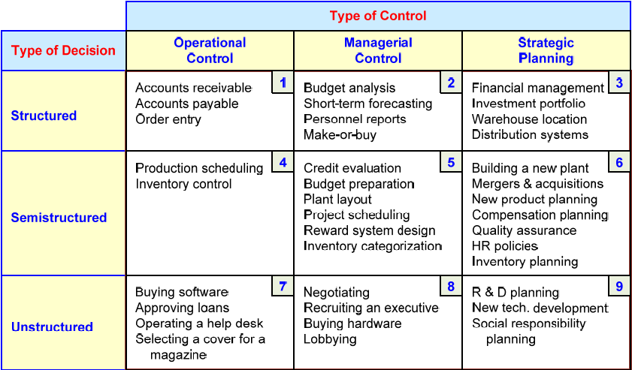
A Decision Support Framework (by Gory and Scott-Morten, 1971)
Department of Computer Engineering, VIIT , Pune-48

Slide 15
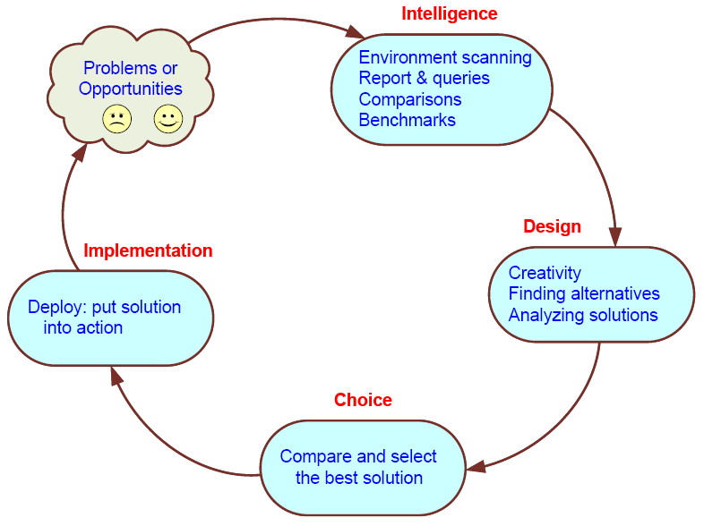
Simon’s Decision-Making Process
Department of Computer Engineering, VIIT , Pune-48

Slide 16
Why Decision Support System?
16
Department of Computer Engineering, VIIT , Pune-48
Notes:
16
16

Slide 17
Changing Business Environment
Companies are moving aggressively to computerized support of their operations => Business Intelligence
Business Pressures–Responses–Support Model
Business pressures result of today's competitive business climate
Responses to oppose(answer) the pressures
Support to better facilitate the process
Department of Computer Engineering, VIIT , Pune-48
Notes:
17
17
17

Slide 18
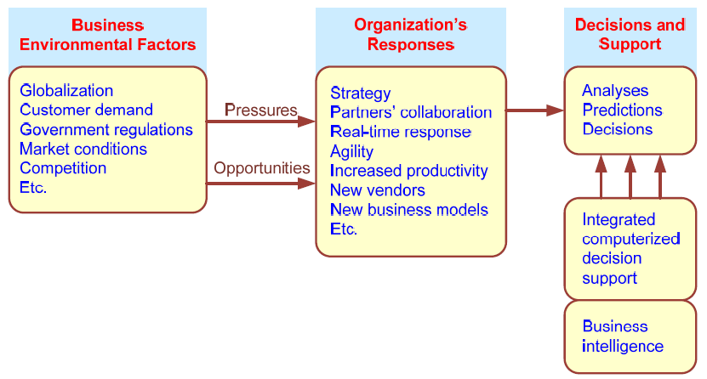
Business Pressures–Responses–Support Model
Department of Computer Engineering, VIIT , Pune-48
Notes:
18
18
18

Slide 19
The Business Environment
The environment in which organizations operate today is becoming more and more complex, creating:
opportunities, and
problems
Example: globalization
Business environment factors:
markets, consumer demands, technology, and societal…
Department of Computer Engineering, VIIT , Pune-48
Notes:
19
19
19

Slide 20
Organizational Responses
Be Reactive, Anticipate(Expressive), Adaptive, and practical
Managers may take actions, such as
Employ calculated planning
Use new and innovative business models
Restructure business processes
Participate in business alliances(agreement between multiple businesses)
Improve corporate information systems
Improve partnership relationships
Encourage innovation and creativity
Department of Computer Engineering, VIIT , Pune-48
Notes:
20
20
20

Slide 21
Managers actions, continued
Modify customer service and relationships
Move to electronic commerce (e-commerce)
Move to on-demand manufacturing and services
Use new IT to improve communication, data access (discovery of information), and modify accordingly
Respond quickly to competitors' actions (e.g., in pricing, promotions, new products and services)
Automate certain decision processes
Improve decision making by employing analytic
Department of Computer Engineering, VIIT , Pune-48
Notes:
21
21
21

Slide 22
Closing the Strategy Gap by Decision Support
One of the major objectives of computerized decision support is to facilitate closing the gap between the current performance of an organization and its desired performance, as expressed in its mission, objectives, and goals, and the strategy to achieve them.
Department of Computer Engineering, VIIT , Pune-48
Notes:
22
22
22

Slide 23
Managerial Decision Making
Management is a process by which organizational goals are achieved by using resources
Inputs: resources
Output: attainment of goals
Measure of success: outputs / inputs
Management ≅ Decision Making
Decision making: selecting the best solution from two or more alternatives
Department of Computer Engineering, VIIT , Pune-48
Notes:
23
23
23

Slide 24
Decision Making Process
Managers usually make decisions by following a four-step process
Define the problem (or opportunity)
Construct a model that describes the real-world problem
Identify possible solutions to the modeled problem and evaluate the solutions
Compare, choose, and recommend a potential solution to the problem
Example Detention, For BE Placement attendance , For TE internship attendance etc.
Department of Computer Engineering, VIIT , Pune-48
Notes:
24
24
24

Slide 25
Decision making is difficult, because
Technology, information systems, advanced search engines, and globalization result in more and more alternatives from which to choose.
Government regulations and the need for agreement, competition, and changing consumer demands produce more uncertainty, making it more difficult to predict consequences and the future.
Other factors are the need to make rapid decisions, the frequent and unpredictable changes that make trial-and-error learning difficult, and the potential costs of making mistakes.
Department of Computer Engineering, VIIT , Pune-48
Notes:
25
25
25

Slide 26
Why Use Computerized DSS
Computerized DSS can facilitate decision via:
Speedy computations
Improved communication and collaboration
Increased productivity of group members
Improved data management
Quality support; agility support
Web: anywhere and anytime support
Department of Computer Engineering, VIIT , Pune-48
Notes:
26
26
26

Slide 27
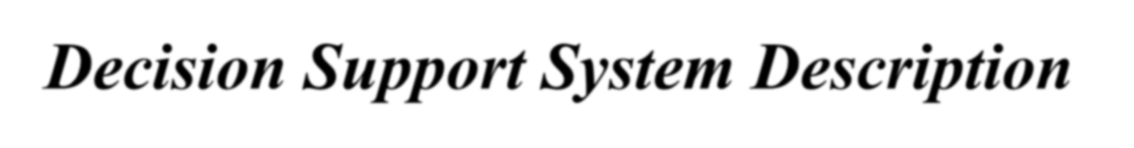

































































14
Standalone,
¹ Semi- and
integrating and Web-based
unstructured problems
² Support managers
at all levels
¹³ Data access
³ Support Individuals
and groups
12 Modeling and analysis
4. Interdependent or sequential decisions
DSS
¹¹ Ease of development
by end users
Support intelligence, design, choice, implementation
Human control the process
⁶
Support variety of decision processes and styles
⁹ Effectiveness
⁸ Interactive
⁷Adaptable and
flexible
ease of use
Notes:
27
27

Slide 28





… Decision Support System Description Characteristics and Capabilities
Support for decision makers (mainly in semi- and un-structured situation) by bringing together human judgment and computerized information.
Support for all managerial levels, ranging from top executives to line
managers.
Support for individuals (from different departments, organizational levels or different organizations) as well as groups of decision makers working somewhat independently – virtual teams through collaborative Web tools.
Support for independent or sequential decisions that may be made once, several times or repeatedly.
Support in all phases of decision-making process (intelligence, design, choice, implementation).
Support for a variety of decision-making process and style.
The decision maker should be reactive, able to tackle changing conditions quickly and able to adapt the DSS to meet these changes. DSS are flexible, so users can add, delete, combine, change or rearrange basic elements.
Department of Computer Engineering, VIIT , Pune-48
Notes:
28
28

Slide 29


… Decision Support System Description Characteristics and Capabilities
User-friendliness, strong graphical capabilities and natural language interactive human-machine interface can greatly increase the effectiveness of DSS, Most new DSS application use Web-based interfaces.
Improvement the effectiveness of decision making rather than its efficiency. When DSS are deployed, decision making often takes longer but the decisions are better.
The decision maker has complete control over all steps of the
decision-making process in solving a problem – a DSS aims to support not to replace the decision maker.
11. End users are able to develop and modify simple systems
by
themselves. Larger systems can be built with assistance from information system specialist. Online analytical process (OLAP) and data mining software, with data warehouses, allow users to build very large and complex DSS.
12. Models are generally utilized to analyze decision-making situations. The modeling capability enable experimentation with different strategies under different configurations.
Department of Computer Engineering, VIIT , Pune-48
Notes:
29
29

Slide 30


… Decision Support System Description Characteristics and Capabilities
Access is provided to a variety of data sources, formats and types, including GIS, multimedia and object oriented.
Can be employed as a standalone tool used by an individual decision maker in one location or distributed throughout an organization and in several organizations along the supply chain. It can be integrated with other DSS or applications and it can be distributed internally and externally using networking and Web technologies.
These key DSS Characteristics and Capabilities allow decision makers to make better, more consistent decision in a timely manner and they are provided by the major DSS components.
Department of Computer Engineering, VIIT , Pune-48
Notes:
30
30

Slide 31
DSS as an Umbrella Term
The term DSS can be used as an umbrella term to describe any computerized system that supports decision making in an organization
E.g. A decision support system specific to an organizational function (marketing, finance, accounting, manufacturing, planning, etc.)
Department of Computer Engineering, VIIT , Pune-48
Notes:
31
31
31

Slide 32
DSS as a Specific Application
In a narrow sense DSS refers to a process for building customized applications for unstructured or semi-structured problems
Components of the DSS Architecture
Data, Model, Knowledge/Intelligence, User Interface (API and/or user interface)
DSS often is created by putting together loosely coupled instances of these components
Department of Computer Engineering, VIIT , Pune-48
Notes:
32
32
32

Slide 33
Typical Architecture
TPS: transaction processing system
MODEL: representation of a problem
OLAP: on-line analytical processing
USER INTERFACE: how user enters problem & receives answers
DSS DATABASE: current data from applications or groups
DATA MINING: technology for finding relationships in large data bases for prediction
DSS DATA
EXTERNAL
TPS
BASE
DATA
DSS SOFTWARE SYSTEM
USER
MODELS
INTERFACE
OLAP
TOOLS
DATA MINING
TOOLS
USER
Department of Computer Engineering, VIIT , Pune-48
Notes:
33
33

Slide 34
Perceived benefits of DSS
Decision Quality
Improved Communication
Cost Reduction
Increased Productivity
Time Savings
Improved customer and employee satisfaction
Department of Computer Engineering, VIIT , Pune-48
Notes:
34
34

Slide 35
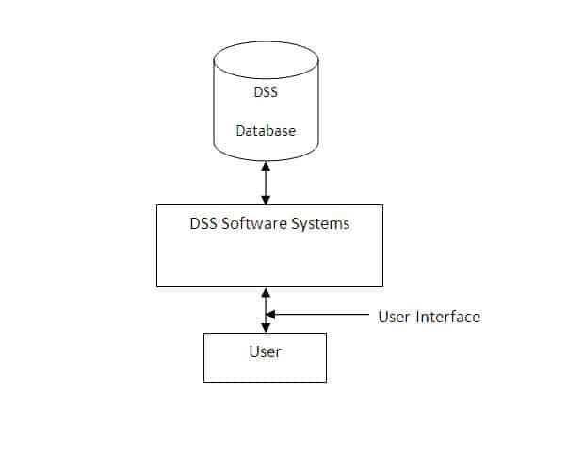
Components of Decision Support Systems (DSS)
Department of Computer Engineering, VIIT , Pune-48
Notes:
35
35
35

Slide 36
Components of Decision Support Systems (DSS)
A decision support systems consists of three main components, namely database, software system and user interface.
DSS Database: It contains data from various sources, including internal data from the organization, the data generated by different applications, and the external data mined form the Internet, etc.
The decision support systems database can be a small database or a standalone system or a huge data warehouse supporting the information needs of an organization.
Department of Computer Engineering, VIIT , Pune-48
Notes:
36
36
36

Slide 37
Components of Decision Support Systems (DSS)
2. DSS Software System: It consists of various mathematical and analytical models that are used to analyze the complex data, thereby producing the required information. A model predicts the output in the basis of different inputs or different conditions, or finds out the combination of conditions and input that is required to produce the desired output.
A decision support system may compromise different models where each model performs a specific function. The selection of models that must be included in a decision support system family depends on user requirements and the purposes of DSS.
Department of Computer Engineering, VIIT , Pune-48
Notes:
37
37
37

Slide 38
Components of Decision Support Systems (DSS)
Some of the commonly used mathematical and statistical models are as follows:-
Statistical Models: They contain a wide range of statistical functions, such as mean, median, mode, deviations etc. These models are used to establish, relationships between the occurrences of an event and various factors related to that event.
It can, for example, relate sale of product to differences in area, income, season, or other factors. In addition to statistical functions, they contain software that can analyze series of data to project future outcomes.
Department of Computer Engineering, VIIT , Pune-48
Notes:
38
38
38

Slide 39
Components of Decision Support Systems (DSS)
Sensitivity Analysis Models: These are used to provide answers to what-if situations occurring frequently in an organization. During the analysis, the value of one variable is changed repeatedly and resulting changes on other variables are observed.
The sale of product, for example, is affected by different factors such as price, expenses on advertisements, number of sales staff, productions etc. Using a sensitivity model, price of the product can be changed (increased or decreased) repeatedly to ascertain the sensitivity of different factors and their effect on sales volume. Excel spreadsheets and Lotus 1-2-3 are often used for making such analysis.
Department of Computer Engineering, VIIT , Pune-48
Notes:
39
39
39

Slide 40
Components of Decision Support Systems (DSS)
Optimization Analysis Models: They are used to find optimum value for a target variable under given circumstances. They are widely used for making decisions related to optimum utilization of resources in an organization. During optimization analysis, the values for one or more variables are changed repeatedly keeping in mind the specific constraints, until the best values for target variable are found.
They can, for example, determine the highest level of production that can be achieved by varying job assignments to workers, keeping in mind that some workers are skilled and their job assignment cannot be changed. Linear programming techniques and Solver tool in Microsoft excel are mostly used for making such analysis.
Department of Computer Engineering, VIIT , Pune-48
Notes:
40
40
40

Slide 41
Components of Decision Support Systems (DSS)
Forecasting Models: They use various forecasting tools and techniques, including the regression models, time series analysis, and market research methods etc., to make statements about the future or to predict something in advance.
They provide information that helps in analyzing the business conditions and making future plans. These systems are widely used for forecasting sales.
Department of Computer Engineering, VIIT , Pune-48
Notes:
41
41
41

Slide 42
Components of Decision Support Systems (DSS)
Backward Analysis Sensitivity Models: Also known as goal seeking analysis, the technique followed in these models is just opposite to the technique applied in sensitivity analysis models. In place of changing the value of variable repeatedly to see how it affects other variables, goal seeking analysis sets a target value for a variable and then repeatedly changes other variables until the target value is achieved.
To increase the production level by 40 percent using the backward sensitivity analysis, for example, first, the target value for the production level can be set and then the required changes to made in other factors, such as the amount of raw material, machinery and tools, number of production staff, etc., to achieve the target production level.
Department of Computer Engineering, VIIT , Pune-48
Notes:
42
42
42

Slide 43
Components of Decision Support Systems (DSS)
3. DSS User Interface: It is an interactive graphical interface which makes the interaction easier between the DSS and its users. It displays the results (output) of the analysis in various forms, such as text, table, charts or graphics. The user can select the appropriate option to view the output according to his requirement.
A manager, for example, would like to view comparative sales data in tabular form whereas an architect creating a design plan would be more interested in viewing the result of analysis in a graphical format. The present-day decision support system built using the Web-based interface provides its users some special capabilities like better interactivity, facility for customization and personalization, and more ease of use.
Department of Computer Engineering, VIIT , Pune-48
Notes:
43
43
43

Slide 44
Exercise
https://forms.gle/dFdAXsPkBdBC4GoQ9
Department of Computer Engineering, VIIT , Pune-48
Notes:
44
44
44

Slide 45
Types of DSS
Five major types:
Model-Driven DSS
Data-Driven DSS
Communication Driven DSS
Document Driven DSS
Knowledge Driven DSS
Department of Computer Engineering, VIIT , Pune-48
Notes:
45
45
45

Slide 46
Model-driven DSS
Model driven DSSs are complex systems that help analyze decisions or choose between different options.
A model driven DSS emphasizes access to and manipulation of financial, optimization and / or simulation models.
Simple quantitative models provide the most elementary level of functionality.
Model-driven DSS use limited data and parameters provided by decision makers to help in analyzing a situation, but in general large data bases are not needed for model-driven DSS.
Department of Computer Engineering, VIIT , Pune-48
Notes:
46
46

Slide 47
Model-driven DSS
These are used by managers and staff members of a business, or people who interact with the organization, for a number of purposes depending on how the model is set up.
These DSSs can be deployed via software / hardware in stand-alone PCs, client/server systems or the web.
Department of Computer Engineering, VIIT , Pune-48
Notes:
47
47

Slide 48
Model-driven DSS
These systems are standalone systems and they are not connected with other major corporate information systems.
The capability of analysis of these systems is supported by some strong theory (or model) along with a good user interface that makes them easy to use.
The use of various models in these systems helps them to perform what-if and other similar analyses. They are used for creating simulation models, performing production planning and scheduling, and creating statistical and financial reports.
Department of Computer Engineering, VIIT , Pune-48
Notes:
48
48

Slide 49
Model-driven DSS
A model-driven DSS emphasizes access to and manipulation of a statistical, financial, optimization, or simulation model.
Model-driven DSS use data and parameters provided by users to assist decision makers in analyzing a situation;
Dicodess (A software framework for developing Distributed co-operative decision support system) is an example of an open source model-driven DSS generator.
Other examples:
A spread-sheet with formulas in
A statistical forecasting model-statistical forecasting implies the use of statistics based on historical data to project what could happen out in the future. This can be done on any quantitative data: Stock Market results, sales, Housing sales, etc
Department of Computer Engineering, VIIT , Pune-48
Notes:
49
49

Slide 50
Advantages and Disadvantages of Modeling
Advantages
Less expensive than custom approaches or real(actual) systems.
Faster to construct than real systems
Less risky than real systems
Provides learning experience (trial and error)
Future projections are possible
Can test assumptions
Disadvantages
Assumptions about reality may be incorrect
Accuracy of predications often unreliable
Requires conceptual thinking
Department of Computer Engineering, VIIT , Pune-48
Notes:
50
50

Slide 51
Data-driven (retrieving) DSS
A data-driven DSS or data-oriented DSS emphasizes access to and manipulation of a time series of internal company data and sometimes, external data.
Simple file systems accessed by query and retrieval tools provides the basic level of functionality. Data warehouses provide additional functionality. OLAP provides highest level of functionality.
Examples:
Accessing data from database.
Department of Computer Engineering, VIIT , Pune-48
Notes:
51
51

Slide 52
Data-driven (retrieving) DSS
Data driven DSS model puts its emphasis on collected data that is then manipulated to fit the decision maker’s needs.
Most data driven DSSs are targeted at managers, staff and also product / service suppliers.
It is used to query a database or data warehouse to seek specific answers for specific purposes. It is deployed via a main frame system, client server link or via web.
The main techniques that are mostly used in data-based DSS for analyzing the data are online analytical processing (OLAP) and data mining.
Department of Computer Engineering, VIIT , Pune-48
Notes:
52
52

Slide 53
Communication-driven DSS
A communication-driven DSS use network and communication technologies to facilitate collaboration on decision making.
It supports more than one person working on a shared task.
examples include integrated tools like Microsoft's Net Meeting or Video conferencing.
It is related to group decision support systems.
Department of Computer Engineering, VIIT , Pune-48
Notes:
53
53

Slide 54
Communication-driven DSS
A communication driven DSS supports more than one person working on a shared task. Many collaborators work together to come up with a series of decision to set in motion a solution or strategy.
Most communications driven DSSs are targeted at internal teams, including partners. The most commons technology used to deploy the DSS is a web or a client server.
In general, groupware, bulletin boards, audio and video conferencing are the primary technologies for communication driven decision support.
Department of Computer Engineering, VIIT , Pune-48
Notes:
54
54

Slide 55
Document-driven DSS
A document-driven DSS uses storage and processing technologies to document retrieval and analysis.
It manages, retrieves and manipulates unstructured information in a variety of electronic formats.
Document database may include: Scanned documents, hypertext documents, images, sound and video.
A search engine is a primary tool associated with document driven DSS.
Department of Computer Engineering, VIIT , Pune-48
Notes:
55
55

Slide 56
Document-driven DSS
Document driven DSSs are more common, targeted at a broad base of user groups.
The purpose of such a decision support system is to search web pages and find documents on a specific set of keywords or search terms.
This model uses computer storage and processing technologies to provide document retrieval and analysis. A document driven DSS model uses documents in a variety of data type such as text documents, spreadsheets and database records to come up with decisions and manipulate the information to refine strategies.
The usual technology used to set up such decision support systems are via web or a client / server system.
Department of Computer Engineering, VIIT , Pune-48
Notes:
56
56

Slide 57
Knowledge-driven DSS
A knowledge-driven DSS provides specialized problem solving expertise stored as facts, rules, procedures or in similar structures. It suggest or recommend actions to managers.
Examples:
1. MYCIN: A rule based reasoning program which help physicians diagnose blood disease.
2.Expert system
Department of Computer Engineering, VIIT , Pune-48
Notes:
57
57

Slide 58
Growth of DSS into Business Intelligence
Use of DSS moved from specialist to managers, and then whomever, whenever, wherever
Enabling tools like OLAP, data warehousing, data mining, intelligent systems, delivered via Web technology have collectively led to the term “business intelligence” (BI) and “business analytics”
8/31/2020
58
Department of Computer Engineering, VIIT , Pune-48
Notes:
58
58

Slide 59
Knowledge-driven DSS
Knowledge driven DSSs are a catch-all category covering a broad range of systems covering users within the organization setting it up, but may also include others interacting with the organization.
It is essentially used to provide management advice or to choose products or services. Knowledge-driven DSS can suggest or recommend actions to managers. These DSS are person-computer systems with specialized problem-solving expertise.
The expertise consists of knowledge about a particular domain, understanding of problems within that domain, and skill at solving some of these problems.
The typical deployment technology used to set up such systems could be client / server systems, the web, or software running on stand-alone PCs
Department of Computer Engineering, VIIT , Pune-48
Notes:
59
59

Slide 60
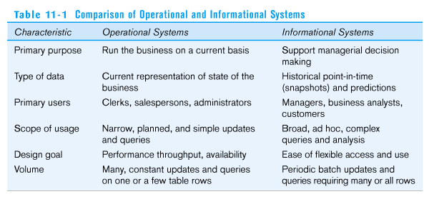
Operational System(Data) and Informational system(Data)
60
Department of Computer Engineering, VIIT , Pune-48
Notes:
60
60

Slide 61
The DSS–BI Connection
First, their architectures are very similar because BI evolved from DSS
Second, DSS directly support specific decision making, while BI provides accurate and timely information, and indirectly support decision making(Ex. Detention)
Third, BI has an executive and strategy orientation, especially in its BPM and dashboard components, while DSS, in contrast, is oriented toward analysts
Department of Computer Engineering, VIIT , Pune-48
Notes:
61
61
61

Slide 62
The DSS–BI Connection – cont.
Fourth, most BI systems are constructed with commercially available tools and components, while DSS is often built from scratch
Fifth, DSS methodologies and even some tools were developed mostly in the academic world, while BI methodologies and tools were developed mostly by software companies
Sixth, many of the tools that BI uses are also considered DSS tools (e.g. data mining and predictive analysis are core tools in both)
Department of Computer Engineering, VIIT , Pune-48
Notes:
62
62
62

Slide 63
Applications of DSS
There are theoretical possibilities of building such systems in any knowledge domain.
Clinical decision support system for medical diagnosis.
a bank loan officer verifying the credit of a loan applicant
an engineering firm that has bids on several projects and wants to know if they can be competitive with their costs.
DSS is extensively used in business and management. Executive dashboards and other business performance software allow faster decision making, identification of negative trends, and better allocation of business resources.
A growing area of DSS application, concepts, principles, and techniques is in agricultural production, marketing for sustainable development.
A specific example concerns the Canadian National Railway system, which tests its equipment on a regular basis using a decision support system.
A DSS can be designed to help make decisions on the stock market, or deciding which area or segment to market a product toward.
Department of Computer Engineering, VIIT , Pune-48
Notes:
63
63
63
A growing area of DSS application, concepts, principles, and techniques is in agricultural production, marketing for sustainable development. For example, the DSSAT4 package, developed through financial support of USAID during the 80's and 90's, has allowed rapid assessment of several agricultural production systems around the world to facilitate decision-making at the farm and policy levels.
A specific example concerns the Canadian National Railway system, which tests its equipment on a regular basis using a decision support system. A problem faced by any railroad is worn-out or defective rails, which can result in hundreds of derailments per year. Under a DSS, CN managed to decrease the incidence of derailments at the same time other companies were experiencing an increase.
DSS has many applications that have already been spoken about. However, it can be used in any field where organization is necessary. Additionally, a DSS can be designed to help make decisions on the stock market, or deciding which area or segment to market a product toward.

Slide 64
Applications
Common Day-to-Day Decision Support System Examples:
Decision support systems operate at many levels, and there are many examples in common day-to-day use.
For example,
GPS route planning determines the fastest and best route between two points by analyzing and comparing multiple possible options. Many GPS systems also include traffic avoidance capabilities that monitor traffic conditions in real time, allowing motorists to avoid congestion.
Farmers use crop-planning tools to determine the best time to plant, fertilize and earn.
Medical diagnosis software that allows medical personnel to diagnose illnesses is another example.
Department of Computer Engineering, VIIT , Pune-48
Notes:
64
64
64

Slide 65
Manual and Hybrid Decision Support System Examples
Numerous manual techniques exist that support decision-making. These include activities such as the SWOT analysis where teams determine their organization's strengths and weaknesses as well as identifying threats facing the organization and potential opportunities for further growth.
The outcomes of a SWOT analysis are actionable decisions for moving the organization forward.
Department of Computer Engineering, VIIT , Pune-48
Notes:
65
65
65

Slide 66
66
References
https://www.managementstudyhq.com/components-of-decision-support-systems.html
https://towardsdatascience.com/zomato-bangalore-data-analysis-6ee83652890f
cbafaculty.org › 23_BI › turban_dss9e_ch01
Department of Computer Engineering, VIIT , Pune-48

Slide 67
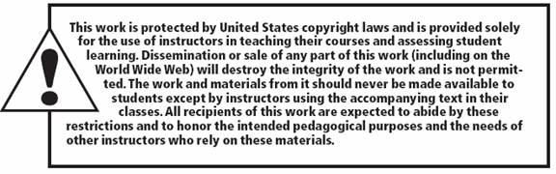
All rights reserved. No part of this publication may be reproduced, stored in a retrieval system, or transmitted, in any form or by any means, electronic, mechanical, photocopying, recording, or otherwise, without the prior written permission of the publisher. Printed in the United States of America.
Copyright © 2011 Pearson Education, Inc.
Publishing as Prentice Hall

Slide 68
68
Thank You
Department of Computer Engineering, VIIT , Pune-48

